Slide 1
Chapter 26 Current and Resistance
Key contents
Resistance and resistivity

Slide 2
Current Density, Drift Speed
When a conductor has a current passing through it, the electrons move randomly, but they tend to drift with a drift speed v_{d} in the direction opposite that of the applied electric field that causes the current. The drift speed is tiny compared with the speeds in the random motion.

Slide 3
Current Density, Drift Speed
In the figure, the equivalent drift of positive charge carriers is in the direction of the applied electric field, E. If we assume that these charge carriers all move with the same drift speed v_{d} and that the current density J is uniform across the wire’s cross-sectional area A, then the number of charge carriers in a length L of the wire is nAL. Here n is the number of carriers per unit volume.

Slide 4
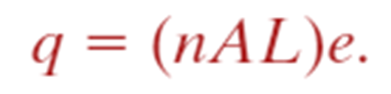
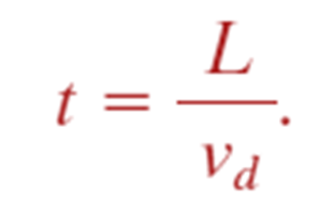
Current Density, Drift Speed
The total charge of the carriers in the length L, each with charge e, is then
The total charge moves through any cross section of the wire in the time interval

Slide 5
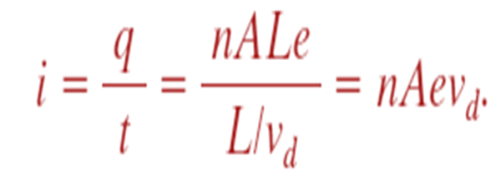
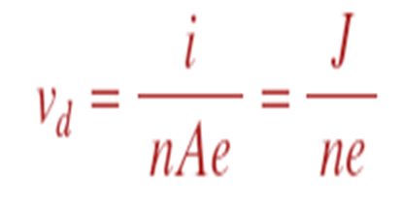
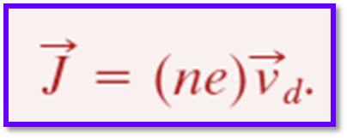
Current Density, Drift Speed

Slide 6
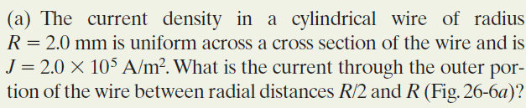
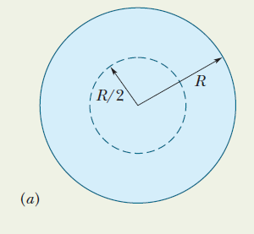
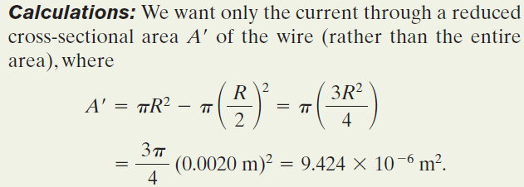
Example, Current Density, Uniform and Nonuniform:

Slide 7
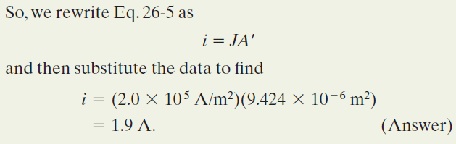
Example, Current Density, Uniform and Nonuniform:

Slide 8
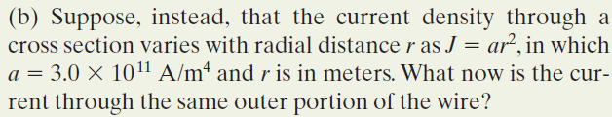
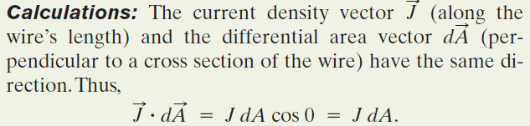
Example, Current Density, Uniform
and Nonuniform, cont.:

Slide 9
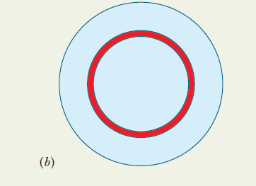
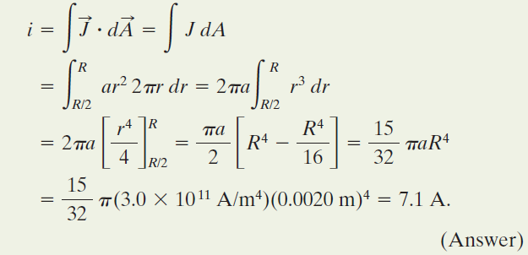
Example, Current Density, Uniform and Nonuniform, cont.:

